Slide 1
Citizen Action Plan for Climate Change
Tristan Dell

Slide 2
Objectives
Development and distribution of materials to inform Indian citizens about climate change, how their actions impact it, and how they can contribute to a sustainable solution to the issue.
Primary data collection, including:
  Self-report surveys
  Interviews
  Observations
Development and publication of a monograph:
  Identifying current state issues and priorities
  Proposing solutions and strategies
  Creation of an action plan

Slide 3
Progress
Based on information gathered via literature review and observations, I have identified the following priorities on the individual level:
Energy, electricity use
Food consumption, waste
Transportation
Garbage and plastic waste

Slide 4
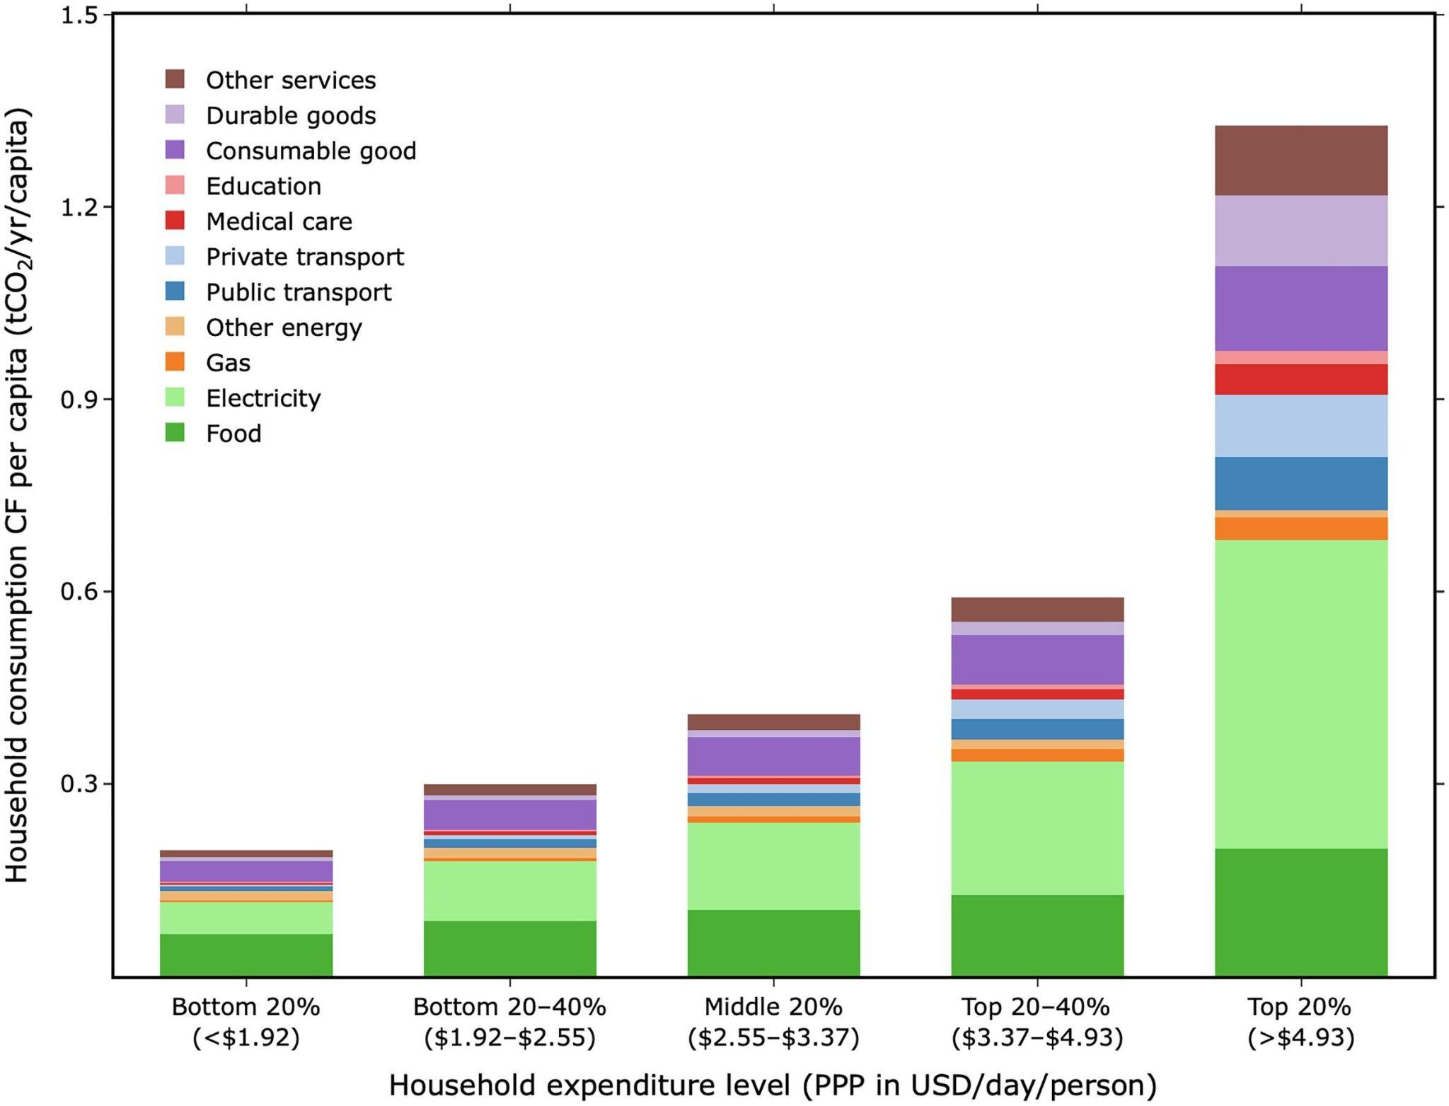
Household electricity use: expenditure & carbon footprint
Electric carbon footprint (CF) shows the most substantial per-capita growth with household expenditure, and spikes with the top 20% households.
These households will be an important target, both because of their disproportionate energy use and the fact that they’re more likely to be reached via digital communications (higher TV ownership, internet use, education, etc.)
(Lee et al., 2021)

Slide 5
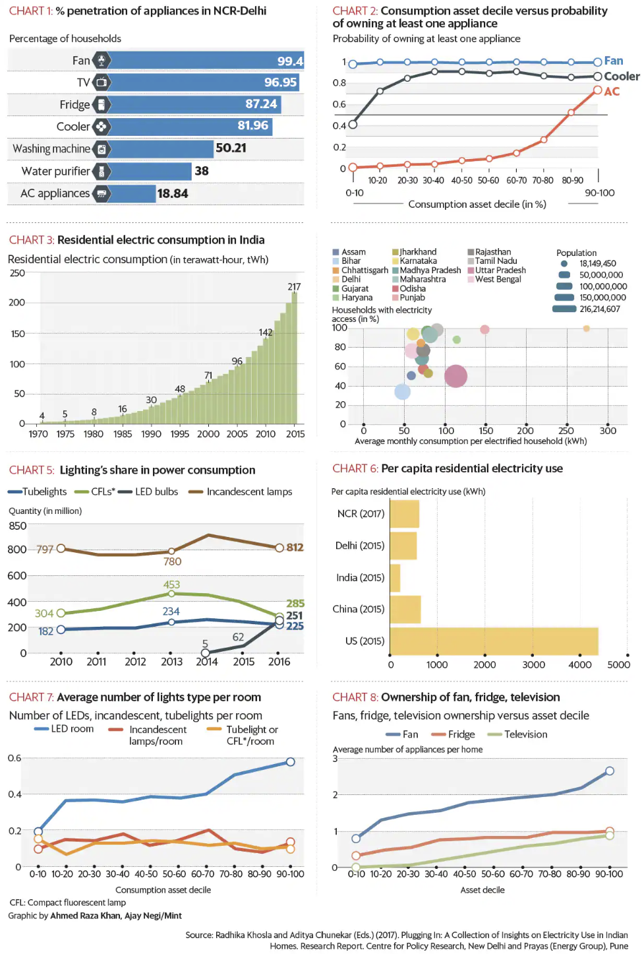
Household electricity use: appliances
NCR-Delhi is an enormous outlier in average household electricity use, with almost every household having a fan, TV, fridge and cooler (Khosla and Chunekar, 2017).
  AC ownership still low.
  Fridge and TV use stagnates around one per household, but fan use rises considerably with asset decile.
LED lights are demonstrably far more efficient than incandescents
  LED prices have dropped sharply due to economy of scale, while demand continues to grow.
  LEDs are the more affordable long-term option, but the upfront cost has many low-income households opting for incandescents.
  “A typical LED bulb saved 2.5 times more in a low income household compared to a high income household. This makes a case for programme to focus more on low income households.”

Slide 6
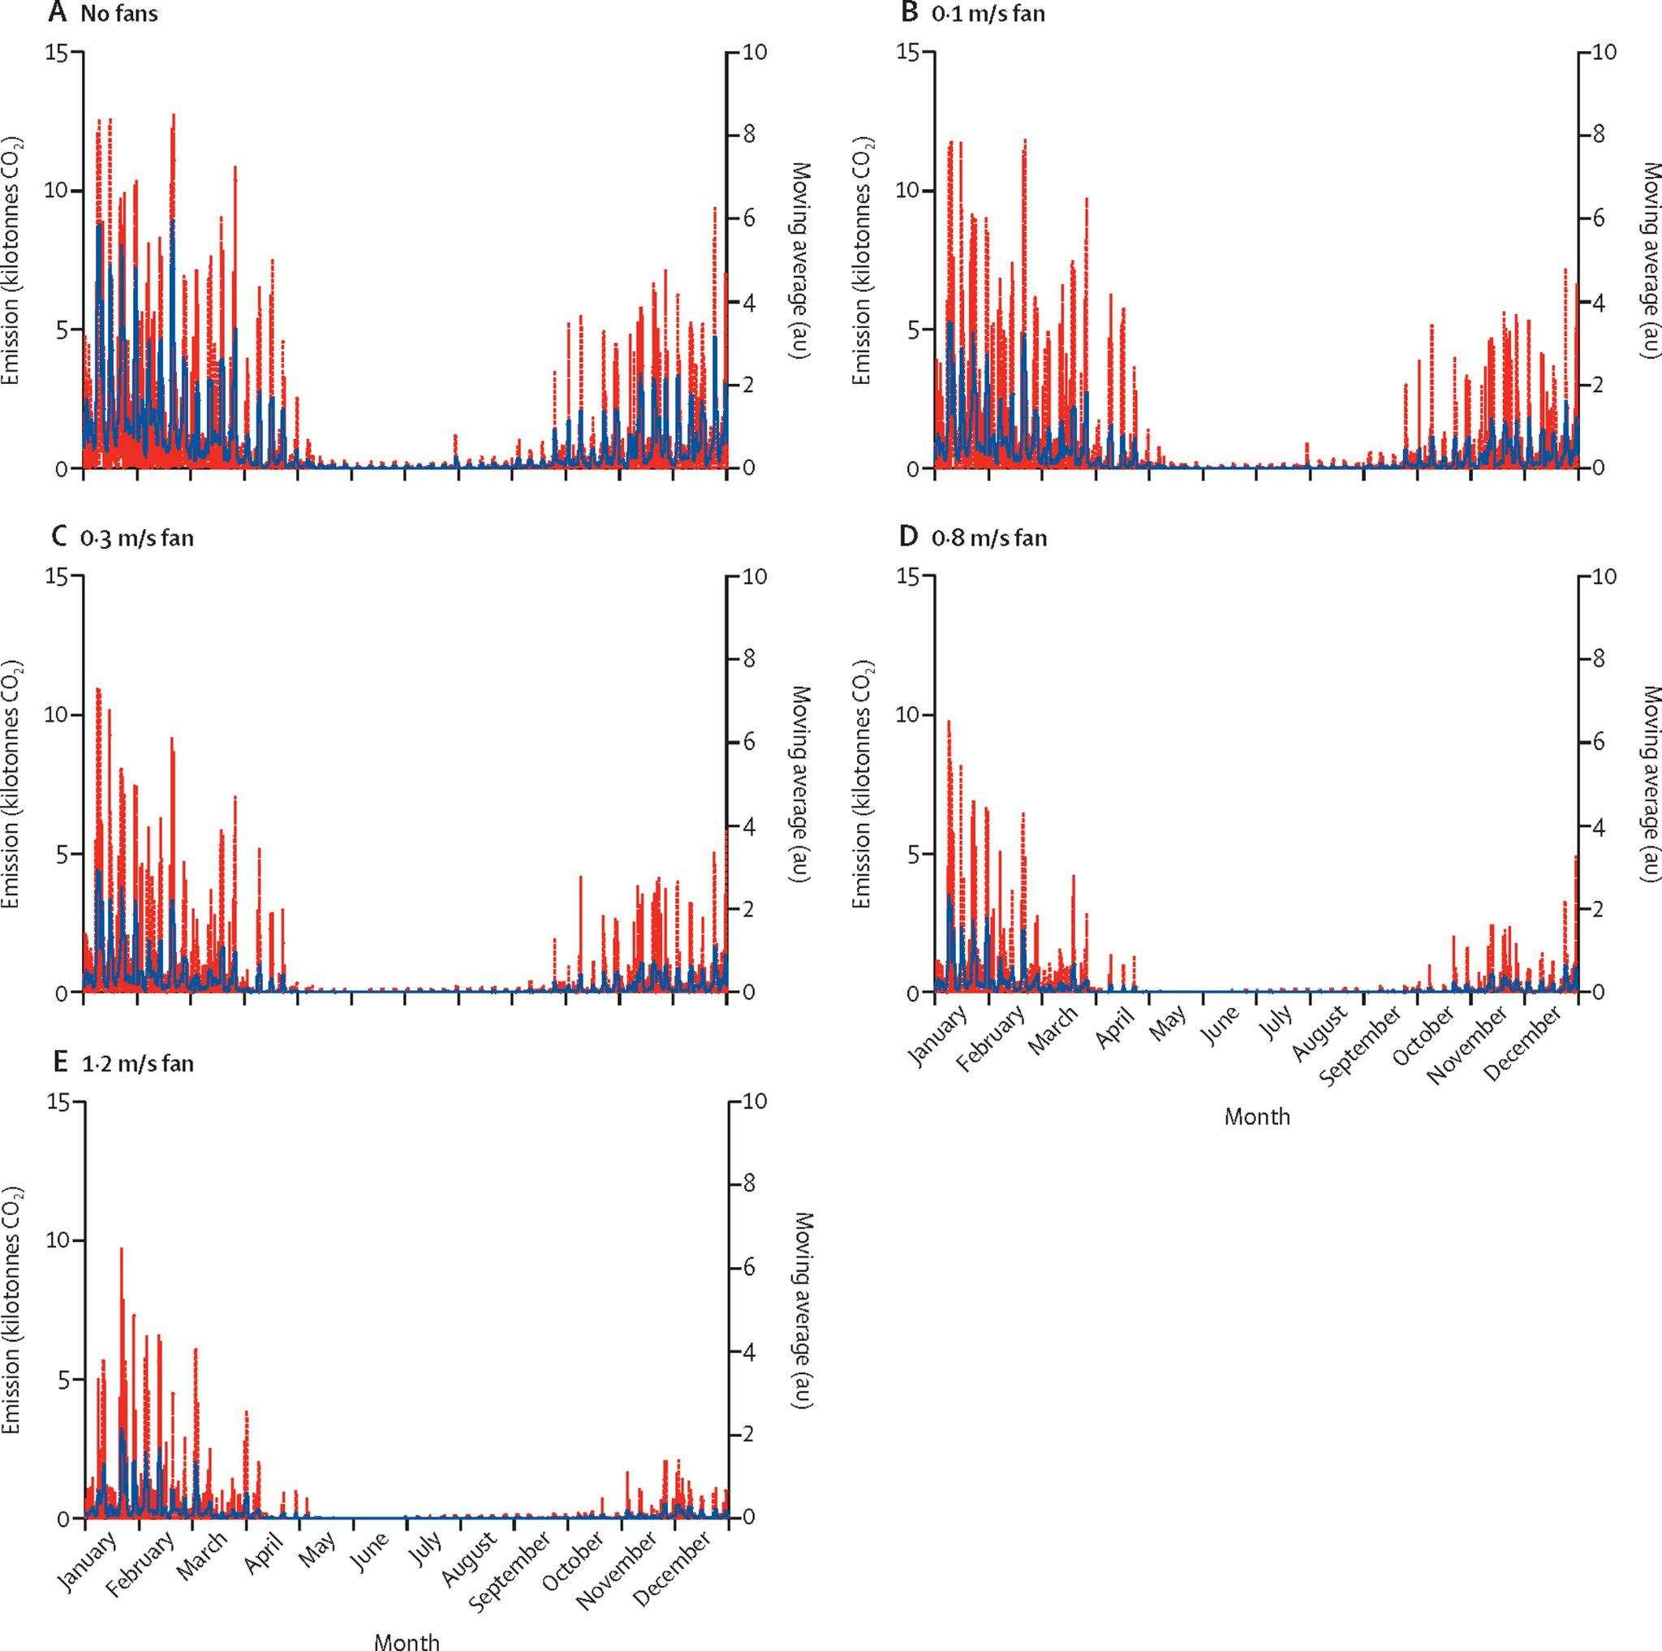
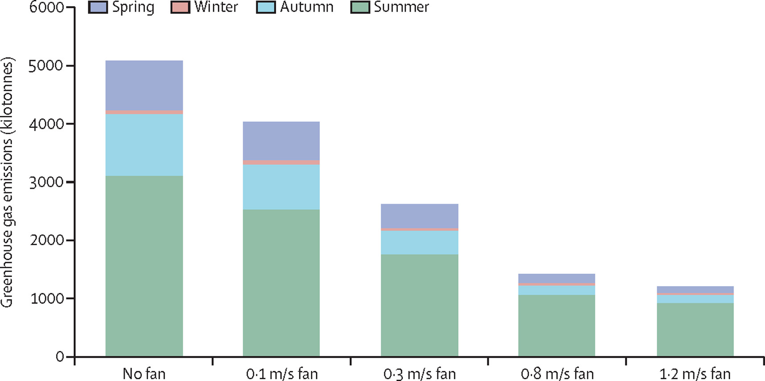
Household electricity use: cooling
As heat rises due to climate change, fan use and particularly AC penetration is likely to rise heavily.
Fans don’t cool a room by themselves, but they do make ACs much more efficient.
  Fans facilitate enormous CO2 emission abatement potential when used with AC.
  “Fan use to raise the operating temperature of air conditioner units offers net financial benefits because the abatement cost falls far below the x axis. Indeed, our analysis indicates a potential abatement cost superior to switching from incandescent to LED home lighting.”
  Coincides with MissionLiFE recommendation to limit AC to 24° C — the mandatory default AC setting (and most efficient and effective) as assessed by India’s Bureau of Energy Efficiency (PIB Delhi, 2020).
(Malik et al., 2022)

Slide 7
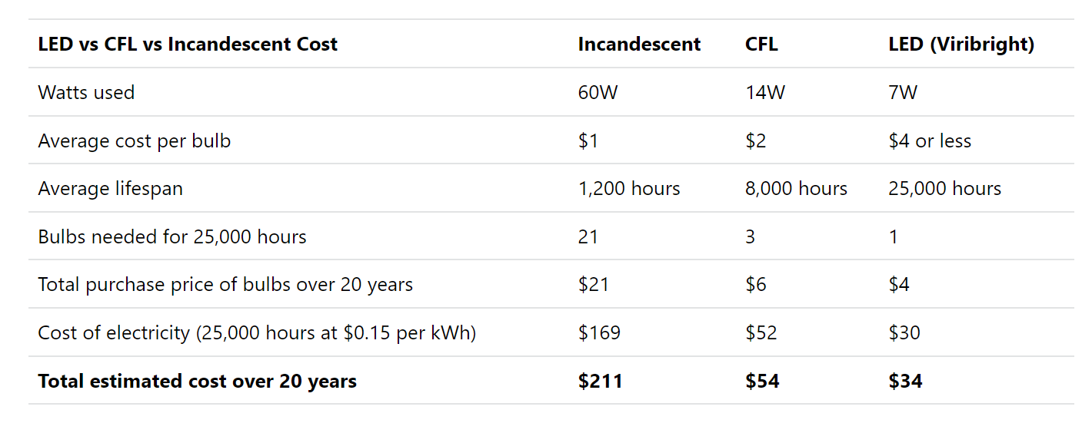
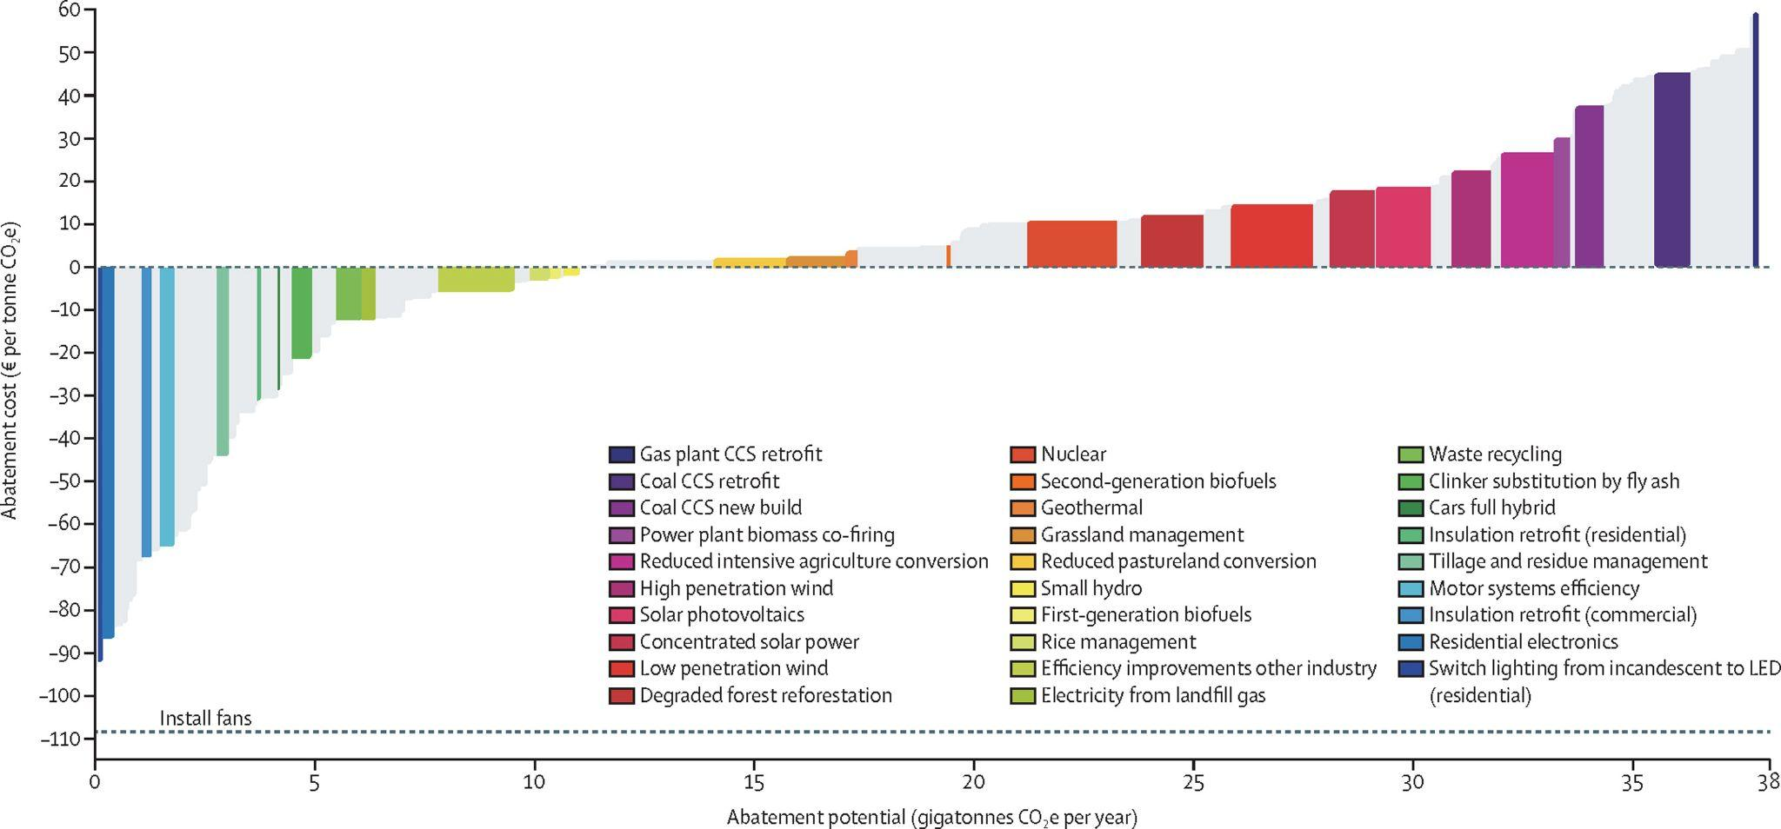
Household electricity use: cooling
Viribright analysis suggests huge long-term savings, waste and electricity usage (and therefore emissions) reduction in households switching from incandescents to LEDs.
Findings by Malik et al. (2022) indicate “possible savings of 4248 GWh (from 5592 GWh to 1344 GWh) in energy consumption and 3882 kilotonnes (from 5091 kilotonnes to 1208 kilotonnes) of emissions per year… transitioning from using air conditioners only in hot weather to air conditioners with 1·2 m/s of indoor air movement with a residential fan.” in Australia.
Larger, slower fans (7.3 m) are shown to be more efficient than conventional ones (Aynsley, 2002).
Fans allow ACs to operate much more efficiently, but the advantage is lost at high fan speeds — so keeping fans to 0.8 m/s as per Malik et al.’s assessment is key.
AC units should also be cleaned once every 2 weeks and either unplugged or with their power source disabled when not in use (TOI Tech Desk, 2024).
(Matt H, 2023)

Slide 8
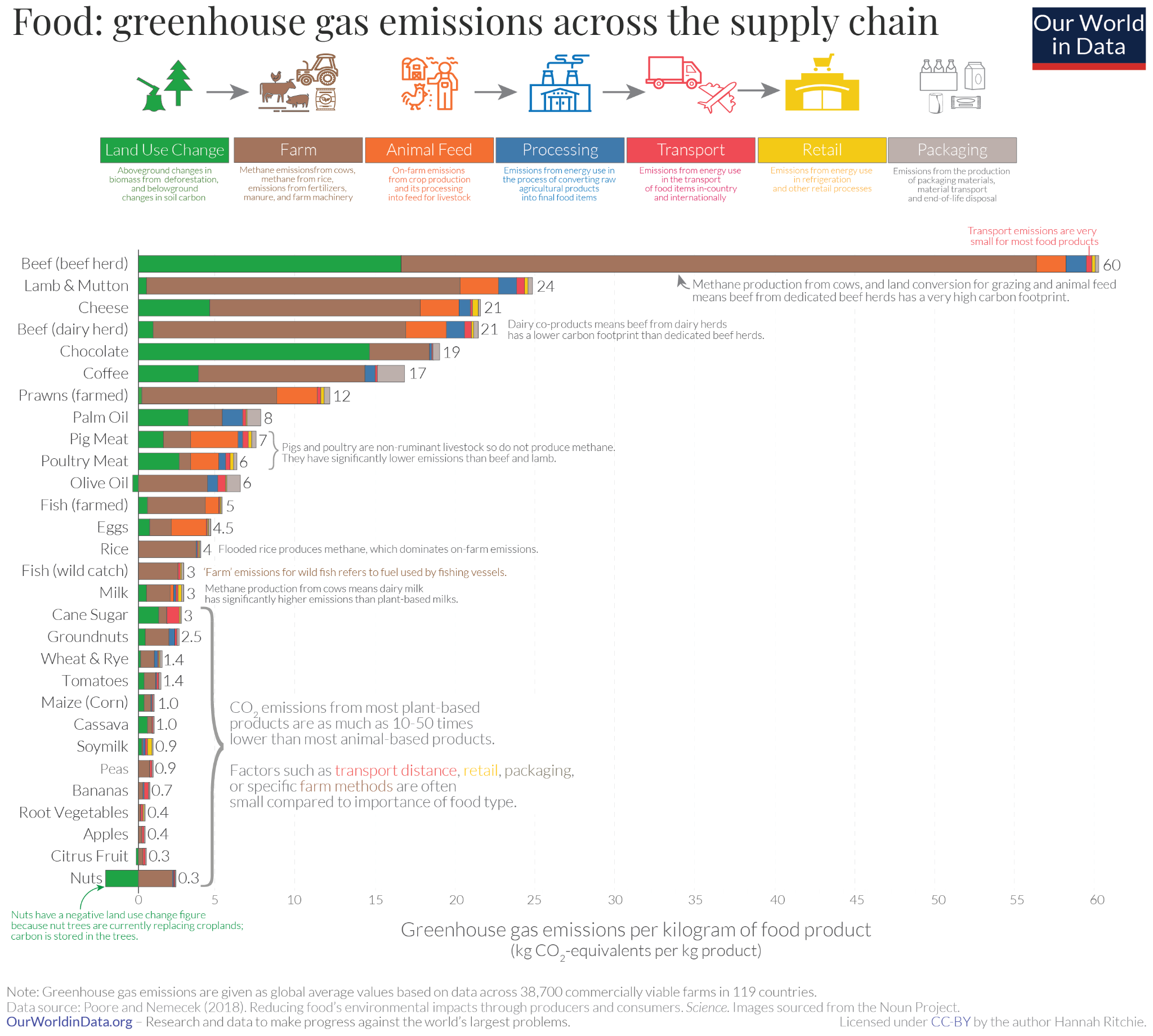
Food consumption
Globally, meat (particularly beef, veal, lamb and mutton) and dairy production contribute the most greenhouse gas emissions of all food sources (Poore and Nemecek, 2018).
  Despite broad recommendations to eat local, what you’re eating is much more important than where it’s from (aside from a very small minority of food that is transported by air).
  Recommendations to plant trees are common, and nuts appear to be a promising solution to reducing emissions while providing nutritious food and creating natural heat sinks.
  It will be best to recommend eschewing dairy-based chocolate, preferably for nut milks or other plant-based alternatives, particularly unsweetened (although cane sugar is still much lower in emissions than dairy milk due to enteric fermentation).
Although cattle slaughter is very controversial in India, it still ranks #5 in beef/veal production globally, including slaughter of water buffalo. (Buchholz, 2021)
  Cows and buffalo account for 92% of livestock methane emissions in India (Samal et al., 2024)

Slide 9
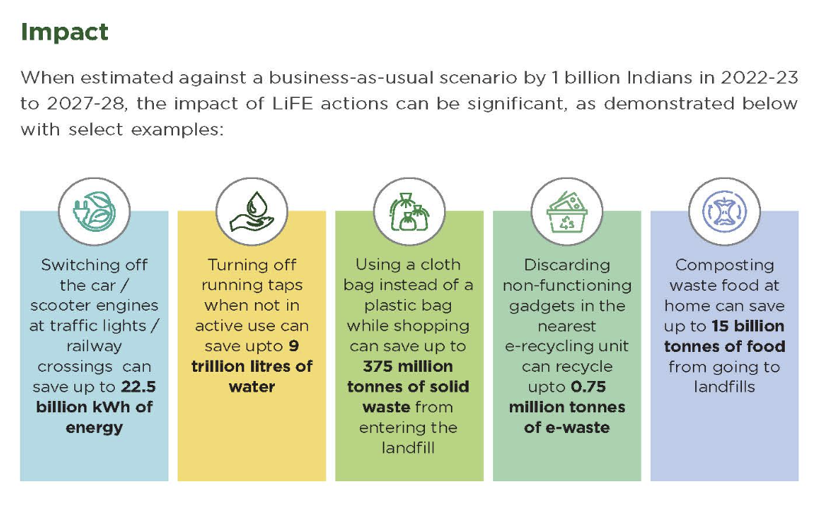
Food waste
Indians composting waste at home can save an estimated 15 billion tonnes of food waste from going to landfills over a 5 year span (MOEFCC, 2024). Turning off running taps while not actively using them (lathering soap on hands before rinsing, rinsing with a weak stream/using small bursts while rinsing) can save up to 9 trillion litres of water in that timespan.
The average Indian household wastes a (medium confidence) estimated 55 kg of food each year (UNEP 2024). As such, about 40% of food produced in India is wasted; total value of annual food waste in India is estimated at ₹92,000 crore ($11 billion USD).
(MissionLiFE, 2024)

Slide 10
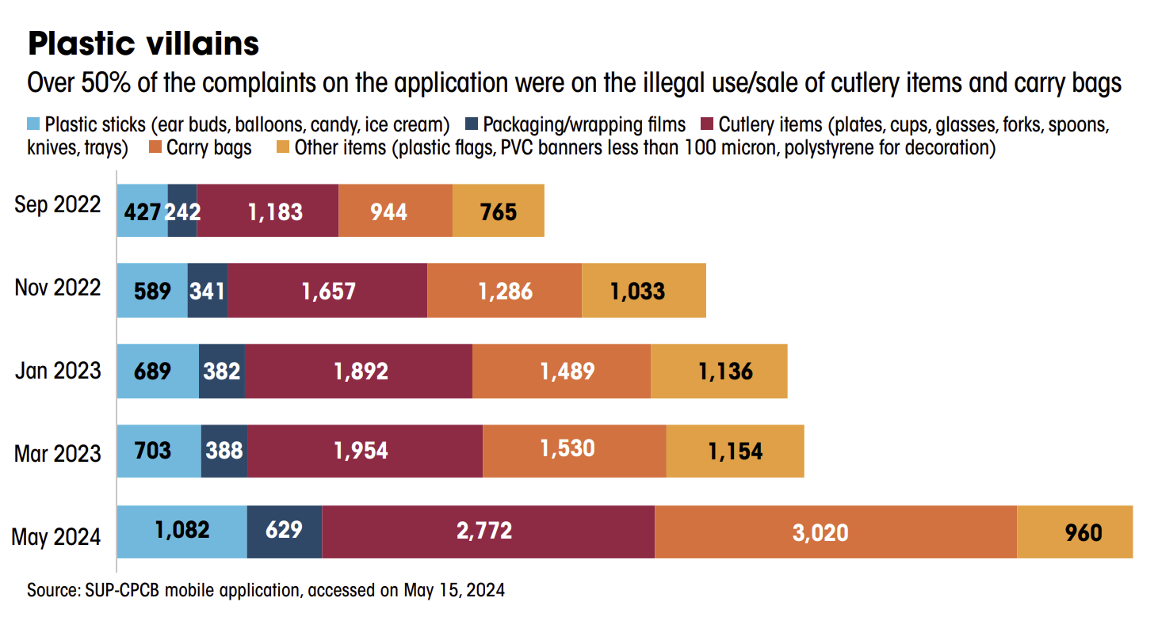
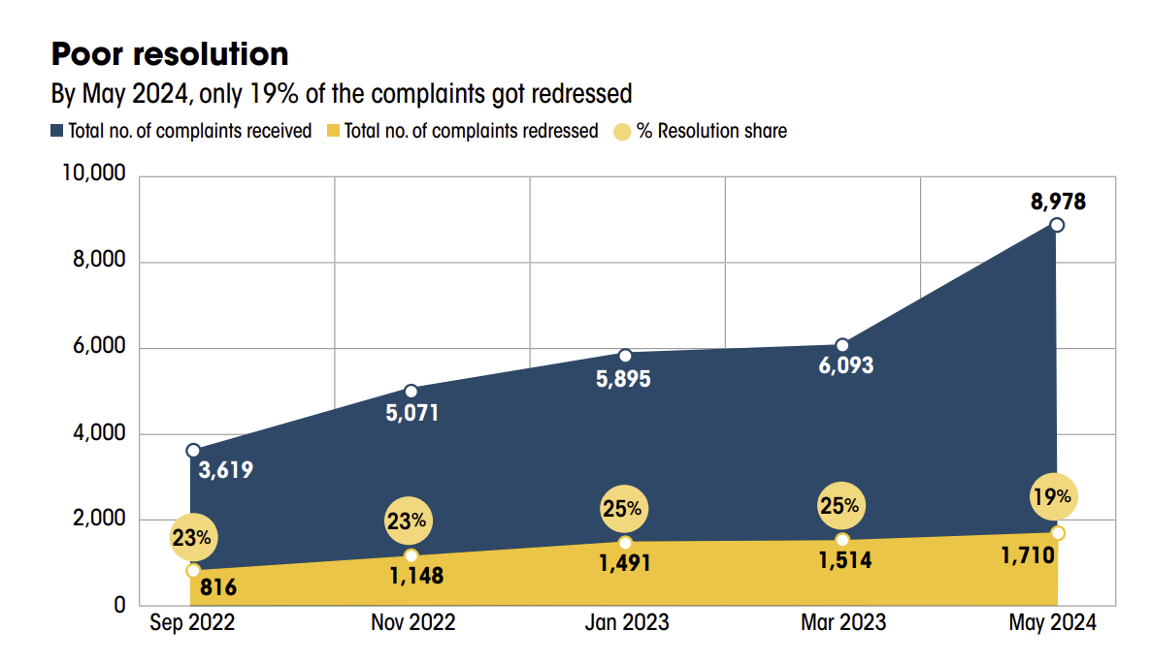
Waste disposal
India’s Central Pollution Control Board (CPCB)’s “SUP-CPCB,” mobile app, which allows Indians to file complaints about illegal pollution, has seen plummeting redressal rates, while complaints using the platform have risen enormously.
“Every day, more than 30,000 tonnes, constituting 21% of total municipal solid waste, remains unprocessed in India, eventually ending in landfills. The number of dumpsites with legacy waste surged in at least 16 states/UTs from 2023 to 2024. Only 17% of India's legacy waste has been dealt with, and plans are underway to address another 26%. No action has been taken on the remaining 56%. Meanwhile, the redressal rate of CPCB's mobile application to report illegal use of plastics has dropped to 19% in May 2024, from 25% in March 2023.” (SOE 2024)

Slide 11
Transportation
Public transit
SOE 2024: 27% of buses with state road transport undertakings (SRTUs) are overaged. They are also under occupied, and 48 of 56 state transport undertakings are under losses.
EVs
As of 2022, the Indian government has invested in schemes to reduce battery prices, slashed GST on EVs, chargers and charging stations, issued green license plates and created permit exemptions for battery-operated vehicles, and advised states to waive road taxes on EVs (PIB Delhi, 2022). Adoption rate is rising considerably, and EVs have jumped to 6.83% of total Indian vehicle registrations in 2023-24, up from 2.49% in 2021-22; however, diesel registrations have held steady around 11% in that time (NITI Aayog, 2024).
Carpooling
Shown to reduce GHG emissions and air pollution, decrease traffic congestion, improve worker morale and productivity, cost savings for public agencies and employers, reduce parking need, increase life expectancy and heighten public awareness about emissions and carbon footprint. (Shaheen et al., 2018)
  Increasing public awareness about the benefits of carpooling will serve not only to increase the amount of people who want to carpool, but also create a cascading effect as they recommend it to people they know and their peers want to join in due to the Jones Effect and social pressure.
  Parking lots are an enormous economic sink; more downtown space for businesses makes a huge splash for the local economy (Marohn, 2016).
Bicycling
A longitudinal study of 7 European cities found that “Daily mobility-related life cycle CO2 emissions were 3.2 kgCO2 per person, with car travel contributing 70% and cycling 1%. Cyclists had 84% lower life cycle CO2 emissions than non-cyclists. Life cycle CO2 emissions decreased by −14% per additional cycling trip and decreased by −62% for each avoided car trip. An average person who ‘shifted travel modes’ from car to bike decreased life cycle CO2 emissions by 3.2 kgCO2/day.” (Brand et al., 2021).

Slide 12
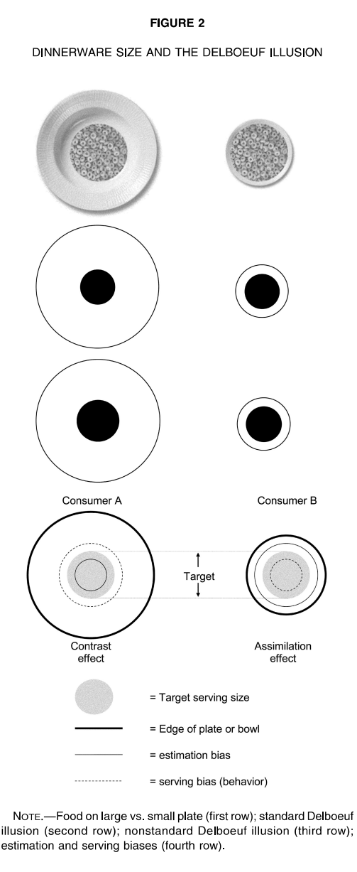
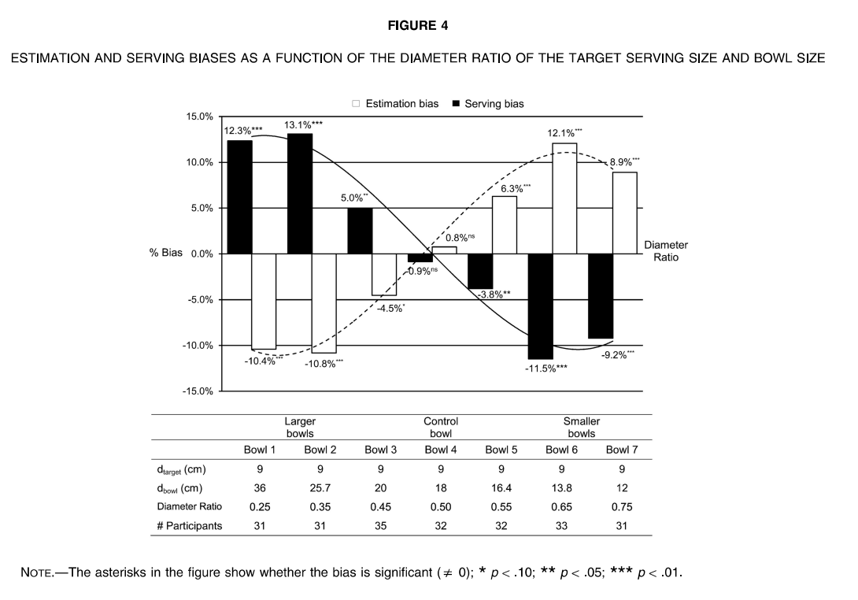
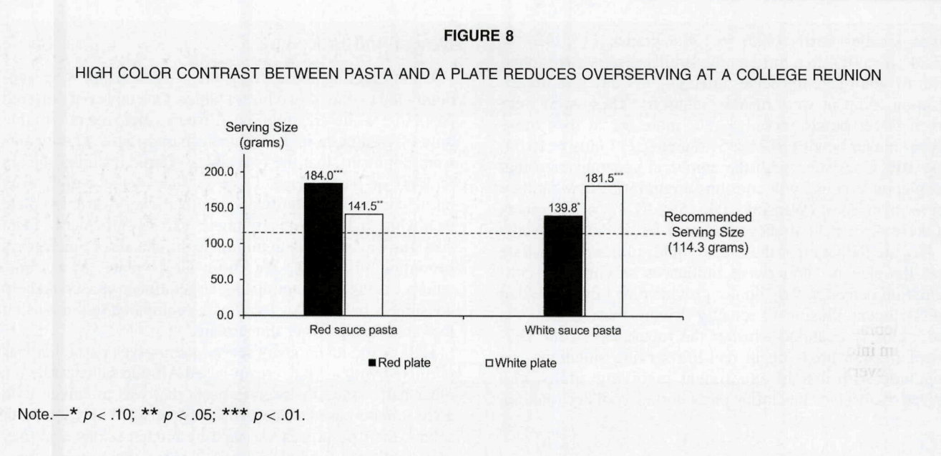
Citizen communications: psychological considerations
The Delboeuf Illusion
Encouraging Indians to buy smaller, white plates over larger, coloured ones may serve to increase satiety from meals, reduce food consumption and consequently reduce both food waste and food-related emissions (Van Ittersum & Wansink, 2011; Peng, 2017).
Limitation: the effect is facilitated in part by high colour contrast, so foods like plain white rice without sauce, yogurt, oats, cereal with milk, etc. may see increased consumption (but even with this limitation it could affect a decrease in meat and cheese consumption, which is the most important target, and thus may still be a worthwhile recommendation).
Data about the most frequent colours in commonly consumed Indian meals would be very helpful.
(Van Ittersum & Wansink, 2011)

Slide 13
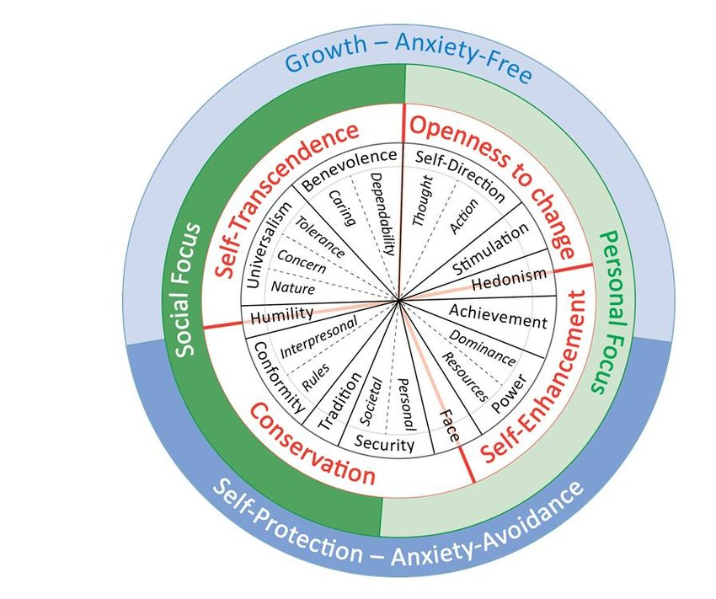
Citizen communications: psychological considerations
Value activation
Activating a given value will tend to promote behaviour associated with this and other compatible values, and to suppress behaviour associated with opposing values (Maio et al., 2009). ‘Priming’ a value leads to ‘bleed over’, such that other compatible values (and associated behaviours) are also bolstered, whereas opposing values (those on the opposite side of the circumplex) are suppressed.
It’s critical to develop appeals that not only galvanize the common citizen to act in a given environmentally-conscious fashion, but prime them to engage in other climate-friendly behaviours as well.
For example, appealing to a self-enhancement value like personal wealth by switching to LEDs or EVs, and then using that money could weaken the effectiveness of an appeal tailored to societal wellbeing, and so framing will be very important.
Rather than appealing to the individual saving money, it could be presented as saving their current family and descendants money, or saving money for their community/government to invest in projects with public benefit.
Schwartz's quasi-circumplex model of values (Schwartz et al., 2012), revised from 1992 version.

Slide 14
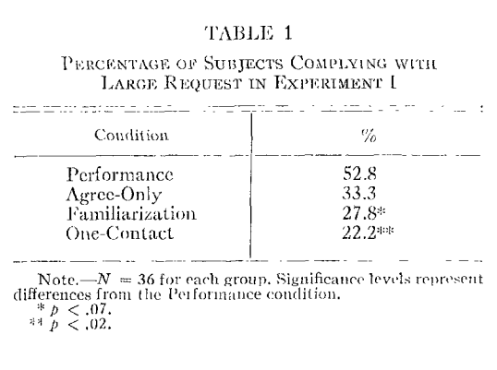
Citizen communications: psychological considerations
Foot in the door
The foot-in-the-door technique is a cornerstone of sales, marketing and fundraising — getting someone to agree to a small request will make them much more likely to accept a larger ask later.
By asking a citizen to eat a just a little less meat, taking the bus instead of driving once a week, etc. it will be much easier to convince them to change their lifestyles more strongly.
While agreement to future compliance with a small request (without any actual follow up to fulfill the request by the receiving party) does increase the odds that a larger request will be carried out, prompt performance of the requested small task drastically increases the rate of acceptance for the larger ask.
  This may be applicable to volunteering as well — a citizen convinced to spend 10 minutes per day picking up garbage will probably be more likely to attend a garbage pickup event or to start picking for 30 minutes a day, and so on.
Possible utility: distributing a short informational survey that uses language associated with benevolence values to prime climate-conscious responses, a la Maio et al. (2009), then concluding the informational with a small task — signing a climate petition, giving a link to share the survey on their social media, a download link for the SUP-CPCB app, etc. and follow this smaller ask up with a larger ask like signing up for participation in a local garbage cleanup.
(Freedman and Fraser, 1966)

Slide 15
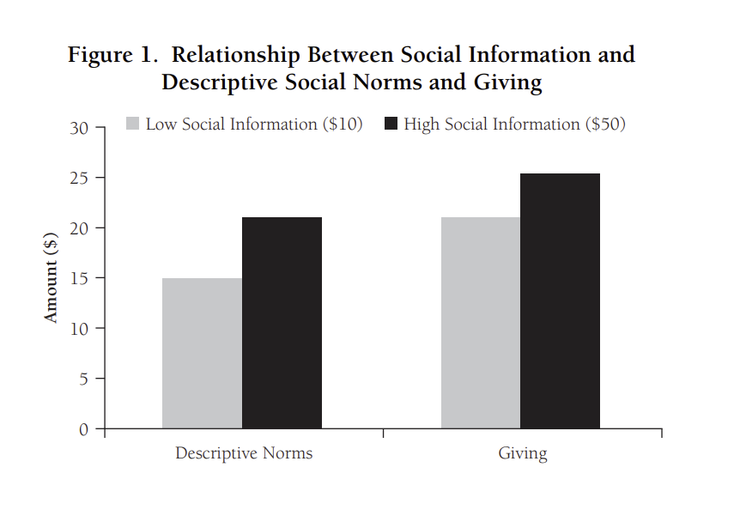
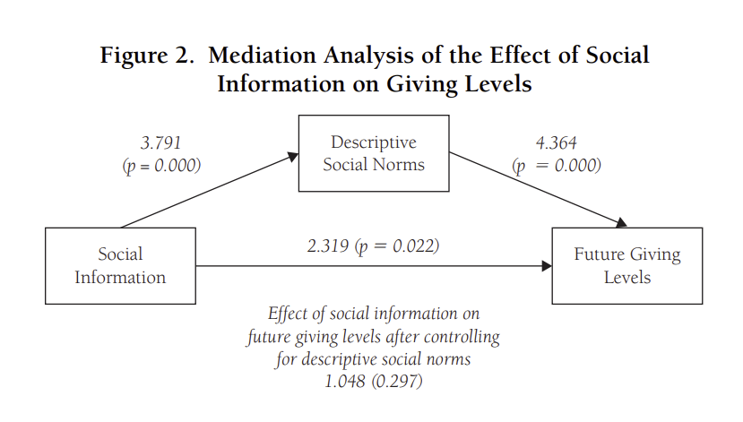
Citizen communications: psychological considerations
Jones Effect
“Social information directly influences the perception of descriptive social norms, and then, through this perception, influences giving levels… The higher the social information, the higher the perceived descriptive norms; and the positive effect that social information has on the levels of contribution is fully mediated by perceived descriptive social norms.” (Croson et al., 2009)
Altruistic behaviour is facilitated by the belief that others are acting altruistically and thus that is socially advantageous to do so.
It’s easier to justify doing something that’s “cooler” or “safer”! The more people doing something, the more normal it seems — and we can convince ourselves to give something a try (and thus open ourselves to value shift) if we don’t risk social ostracism.
https://www.youtube.com/watch?v=GA8z7f7a2Pk

Slide 16
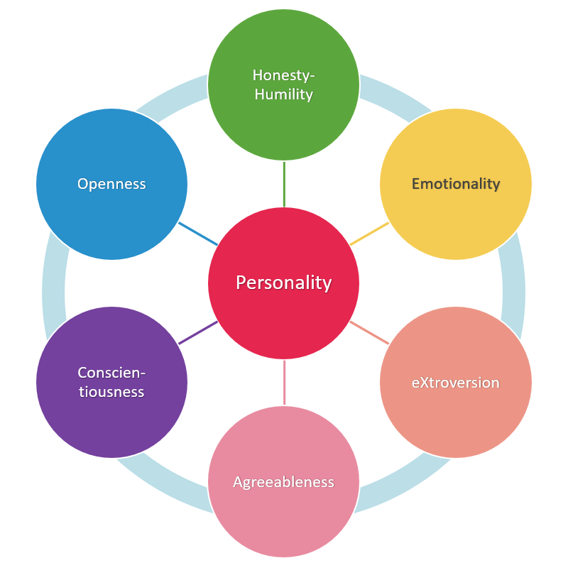
Citizen communications: psychological considerations
The H-Factor of Personality
After a lexical study of European and Asian languages, Ashton et al. (2004) identified a personality factor called “honesty-humility,” which assesses an individual’s likelihood to engage in unethical and self-benefitting behaviours.
This has been argued to be related to cultural values — particular in eastern Asian cultures, where concepts of honour and collective wellbeing are stronger.
Honesty-humility and openness to experience have been found to correlate most strongly with environmentalist attitudes (Soutter et al., 2020)
Thus, encouraging citizens to prioritize collective wellbeing and being open-minded about climate change, social issues, participation in volunteerism will affect a cognitive shift towards a more climate-conscious society.

Slide 17
Why should Indians care about climate change?
The extreme heat wave in India in 2023 resulted in at least 264 deaths, and climate change made the occurrence of the heat wave 30 times more likely (YUPCC, 2024). Worse, the May 2024 heat wave that spanned across Asia was made 45 times more likely with a temperature 0.85 degrees Celsius hotter (WWA, 2024). This occurred during the Indian general election, negatively impacting the capacity of citizens to participate in democracy.
Extreme rainfall in late July triggered landslides that blocked hundreds of roads and killed hundreds of people (WWA, 2024). Rising global temperatures have made severe weather events much more frequent, and will only continue to do so.
India is one of the countries most impacted by climate change, with 17 in 20 Indians in danger of climate disaster (Unicef) but also one of the most capable to spearhead climate action.
India has one of the highest gross CO2 emissions by country, but also relatively low per capita emissions. With the largest population in the world, keeping per capita emissions and engaging in a green transition will best suit India’s interests and serve as a proof of concept to the rest of the world.
India has one of the highest potentials for renewable energy of any country, and utilizing this more extensively while transitioning away from emitting power sources will improve the standard of living for all Indians.

Slide 18
What can Indians do?
The good news: the vast majority of Indians surveyed in a 2023 study expressed caring about climate change, with 84% of survey respondents in support of banning new coal power plants and shutting them down to be replaced by solar and wind energy generation (YUPCC, 2024).
Indians care about climate change; the key to stopping it is galvanizing the people and converting concern to action.
It’s not just about getting individuals to adopt sustainable lifestyle habits, but fostering collective action by encouraging citizens to involve their friends and family in sustainable habits and activities.
By working together, the people can defeat the issue of climate change much more efficiently and instill sustainable practices in future generations.
Taking a few hours for garbage cleanup; eating less meat and dairy; planting trees (especially nut trees!); keeping AC at 24 degrees Celsius with a large, slow ceiling fan running; using LED lights; composting; and driving an EV or taking public transit are all simple methods for individuals to reduce their climate impact.

Slide 19
How can we use this information to make a change?
Inform Indians about effective climate actions, and encourage them to act!
  Distributing brochures and virtual messaging, giving presentations in schools and elsewhere, and challenging people to tell everyone they know about practical solutions for climate change, and banding together to mitigate the problem.
Pressure government officials and companies to do better!
  If citizens demand climate action, while voting and consuming accordingly, this will incentivize organizations to follow the pressure and participate in building a more sustainable future.

Slide 20
My learning during this internship!
Aside from the knowledge I gained as part of my research, I have also learned a lot about India!
Indian and Canadian culture have their differences, but we also share many values!
  Kindness and charitability are valued in India, and I have met many friendly and welcoming people while I’ve been here!
  Many Indians are aware of climate change and care deeply about it, in part due to a widespread sense of collective wellbeing. This care for others is something that I want to help instill in other Canadians.
India sees unique hardships that are most impactful firsthand. Our arrival here at the end of June coincided with a heat wave, which is becoming more and more common for Indians.
Growing temperatures are something that affect Indians’ everyday life, and I have the luxury of going back to the Canadian cold. That privilege is something that I want to keep in mind and use as fuel in my future research climate activism.

Slide 21
My challenges during this internship…
My internship has been very enjoyable overall, but has also been challenging in several ways.
As a Canadian, the heat has been very difficult to tolerate at times.
I’ve been sick for a considerable amount of time while here, which has resulted in not getting as far as I wanted with my project.
Before the internship, I had never been to another country. Getting used to the differences in lifestyle was a unique experience that hadn’t had before.
Being away from family and friends has been a challenge of its own, but luckily, I have met wonderful people here in India and made friendships I will never forget!

Slide 22
THANK YOU!
To all the staff and students at IDC, thank you so much for being so welcoming to all the SICI interns! I can’t wait for the next time I can come back to India and see everyone again!

Slide 23


Slide 24
References
[1] Lee, J., Taherzadeh, O., & Kanemoto, K. (2021). The scale and drivers of carbon footprints in households, cities and regions across India. Global Environmental Change, 66. https://doi.org/10.1016/j.gloenvcha.2020.102205
[2] Khosla, Radhika & Chunekar, Aditya. (2017). Plugging In: A Collection of Insights on Electricity Use in Indian Homes. 10.13140/RG.2.2.26200.19204.
[3] Malik, A., Bongers, C., McBain, B., Rey-Lescure, O., Dear, R. de, Capon, A., Lenzen, M., & Jay, O. (2022). The potential for indoor fans to change air conditioning use while maintaining human thermal comfort during hot weather: An analysis of energy demand and associated greenhouse gas emissions. The Lancet Planetary Health, 6(4). https://doi.org/10.1016/s2542-5196(22)00042-0
[4] BEE Notifies New Energy Performance Standards for Air Conditioners. Press Information Bureau. (2020, January 6). https://pib.gov.in/PressReleasePage.aspx?PRID=1598508#:~:text=All%20Room%20Air%20Conditioners%20to,Celsius%20from%20Jan%201%2C%202020&text=The%20Central%20Government%20in%20consultation,on%2030th%20October%202019.
[5] H, M. (2023, August 10). Comparing LED vs CFL vs Incandescent Light Bulbs. Viribright. https://viribright.com/blogs/insights/comparing-led-vs-cfl-vs-incandescent-light-bulbs
[6] Aynsley, R. (2002). Fan Size and Energy Efficiency. International Journal of Ventilation, 1(1), 33–38. https://doi.org/10.1080/14733315.2002.11683619
[7] TOI Tech Desk. (2024, May 25). 10 things you may be doing wrong with your AC. The Times of India. https://timesofindia.indiatimes.com/technology/tech-tips/10-things-you-may-be-doing-wrong-with-your-ac/articleshow/110381409.cms
[8] Poore, J., & Nemecek, T. (2018). Reducing food’s environmental impacts through producers and consumers. Science, 360(6392), 987–992. https://doi.org/10.1126/science.aaq0216
[9] Buchholz, K. (April 27, 2021). The Biggest Producers of Beef in the World [Digital image]. Retrieved July 15, 2024, from https://www-statista-com.login.ezproxy.library.ualberta.ca/chart/19127/biggest-producers-of-beef/
[10] Samal, A., Sahu, S.K., Mishra, A., Mangaraj, P., Pani, S.K., Beig, G. (2024). Assessment and Quantification of Methane Emission from Indian Livestock and Manure Management. Aerosol Air Qual. Res. 24, 230204. https://doi.org/10.4209/aaqr.230204

Slide 25
References
[11] Narain, S. (2024). State of India’s Environment 2024: A Down To Earth Annual. Centre for Science and Environment.
[12] United Nations Environment Programme. (2024, March 27). Food Waste Index Report 2024. Think Eat Save: Tracking Progress to Halve Global Food Waste. https://wedocs.unep.org/handle/20.500.11822/45230
[13] Press Information Bureau. (2022, July 19). Over 13 lakh Electric Vehicles in use in India; Centre is taking a number of steps to promote use of electric vehicles in India. Retrieved July 17, 2024, from https://pib.gov.in/PressReleasePage.aspx?PRID=1842704.
[14] Shaheen, S., Cohen, A., & Bayen, A. (2018). The Benefits of Carpooling. UC Berkeley: Transportation Sustainability Research Center. http://dx.doi.org/10.7922/G2DZ06GF Retrieved from https://escholarship.org/uc/item/7jx6z631
[15] Marohn, C. L. (2016). Thoughts on Building Strong Towns. CreateSpace Independent Publishing Platform.
[16] Brand, C., Dons, E., Anaya-Boig, E., Avila-Palencia, I., Clark, A., de Nazelle, A., Gascon, M., Gaupp-Berghausen, M., Gerike, R., Götschi, T., Iacorossi, F., Kahlmeier, S., Laeremans, M., Nieuwenhuijsen, M. J., Pablo Orjuela, J., Racioppi, F., Raser, E., Rojas-Rueda, D., Standaert, A., … Int Panis, L. (2021). The climate change mitigation effects of daily active travel in cities. Transportation Research Part D: Transport and Environment, 93, 102764. https://doi.org/10.1016/j.trd.2021.102764
[17] Maio, G. R., Hahn, U., Frost, J.-M., & Cheung, W.-Y. (2009). Applying the value of equality unequally: Effects of value instantiations that vary in typicality. Journal of Personality and Social Psychology, 97(4), 598–614. https://doi.org/10.1037/a0016683
[18] Schwartz, Shalom H; Cieciuch, Jan; Vecchione, Michele; Davidov, Eldad; Fischer, Ronald; Beierlein, Constanze; Ramos, Alic; Verkasalo, Markku; Lönnqvist, Jan-Erik; Demirutku, Kursad; Dirilen-Gumus, Ozlem; Konty, Mark (2012). Refining the theory of basic individual values. Journal of Personality and Social Psychology, 103(4):663-688. DOI: https://doi.org/10.1037/a0029393
[19] Van Ittersum, K., & Wansink, B. (2011b). Plate Size and Color Suggestibility: The Delbouef Illusion’s Bias on Serving and Eating Behavior. Journal of Consumer Research, 39(2), 215–228. https://doi.org/10.1086/662615
[20] Peng M. (2017). How does plate size affect estimated satiation and intake for individuals in normal-weight and overweight groups?. Obesity science & practice, 3(3), 282–288. https://doi.org/10.1002/osp4.119

Slide 26
References
[21] Freedman, J. L., & Fraser, S. C. (1966). Compliance without pressure: The foot-in-the-door technique. Journal of Personality and Social Psychology, 4(2), 195–202. https://doi.org/10.1037/h0023552
[22] Croson, R., Handy, F., & Shang, J. (2009). Keeping up with the Joneses: The relationship of perceived descriptive social norms, social information, and charitable giving. Nonprofit Management and Leadership, 19(4), 467–489. https://doi.org/10.1002/nml.232
[23] Ashton, M. C., Lee, K., Perugini, M., Szarota, P., de Vries, R. E., Di Blas, L., Boies, K., & De Raad, B. (2004). A Six-Factor Structure of Personality-Descriptive Adjectives: Solutions From Psycholexical Studies in Seven Languages. Journal of Personality and Social Psychology, 86(2), 356–366. https://doi.org/10.1037/0022-3514.86.2.356
[24] Soutter, A. R. B., Bates, T. C., & Mõttus, R. (2020). Big Five and HEXACO Personality Traits, Proenvironmental Attitudes, and Behaviors: A Meta-Analysis. Perspectives on Psychological Science, 15(4), 913-941. https://doi.org/10.1177/1745691620903019
[25] Leiserowitz, A., Thaker, J., Verner, M., Goddard, E., Carman, J., Rosenthal, S., Modala, N., Talwar, M., Deshmukh, Y., Shukla, G., Marlon, J., Ballew, M., & Goldberg, M. (2024). Climate Change in the Indian Mind, 2023. Yale University. New Haven, CT: Yale Program on Climate Change Communication.
[26] Climate change made the deadly heatwaves that hit millions of highly vulnerable people across Asia more frequent and extreme. World Weather Attribution. (2024, May 14). https://www.worldweatherattribution.org/climate-change-made-the-deadly-heatwaves-that-hit-millions-of-highly-vulnerable-people-across-asia-more-frequent-and-extreme/
[27] Landslide triggering rainfall made more intense by human-induced climate change, devastating highly vulnerable communities in northern Kerala. World Weather Attribution. (2024b, August 14). https://www.worldweatherattribution.org/landslide-triggering-rainfall-made-more-intense-by-human-induced-climate-change-devastating-highly-vulnerable-communities-in-northern-kerala/
[28] Climate Change and Environmental Sustainability. UNICEF India. (n.d.). https://www.unicef.org/india/what-we-do/climate-change

